Slide 1

Healthy Digital Habits
Developers
Cody Bergman, Isaac Eberhard, Trevor Lemert, Ethan Byers, Tyler Likens
Faculty Advisor
MD Romael Haque
Project Sponsors
Dr. Brandon McDaniel and Dr. Jessica Pater
Notes:
About Team profile, Overview of project / Problem statement, Expected deliverable system, Must complete requirements, Stretch goals, Challenges – Plan, Success factors, Risk lists and alternative solution

Slide 2
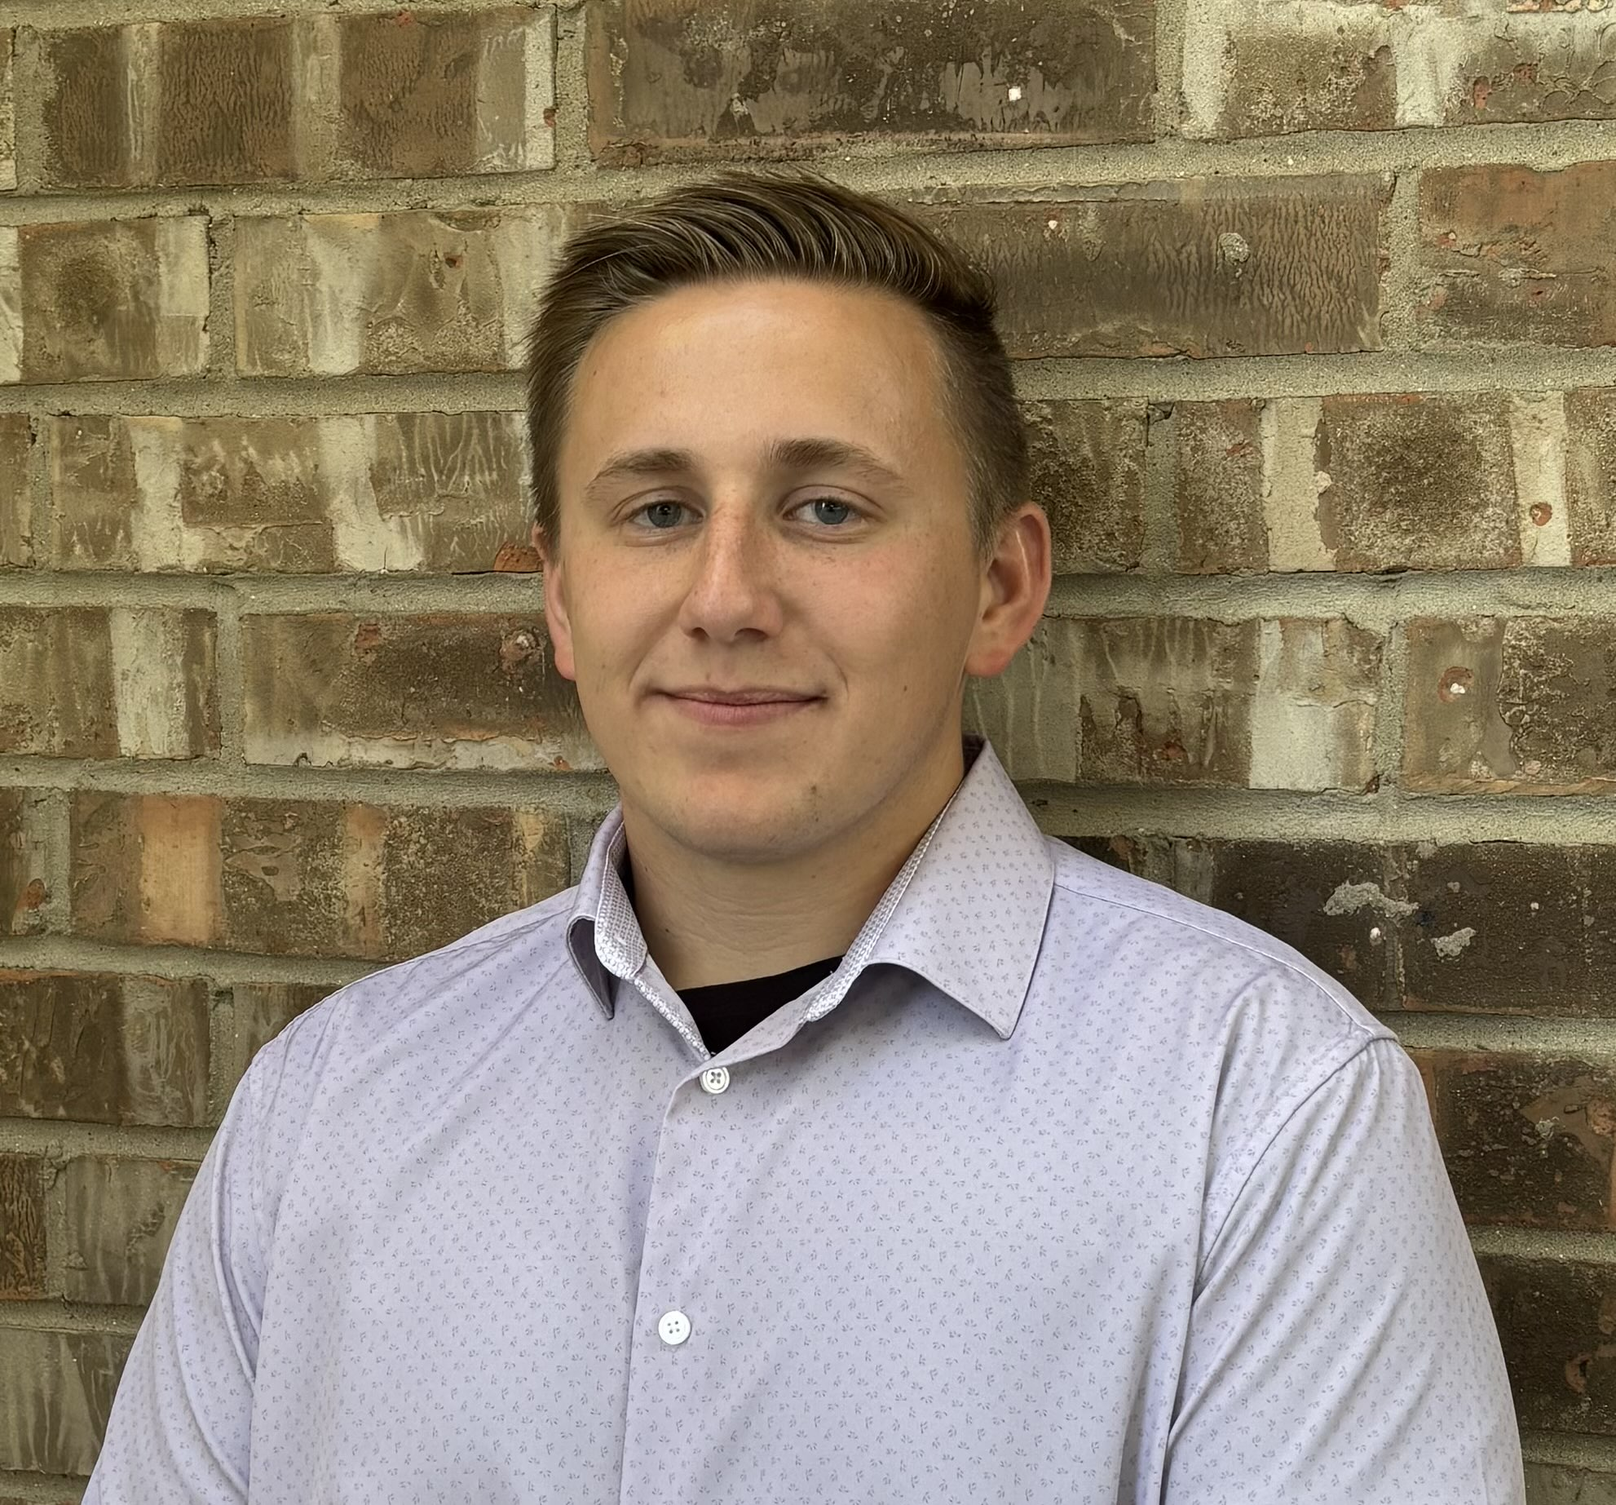
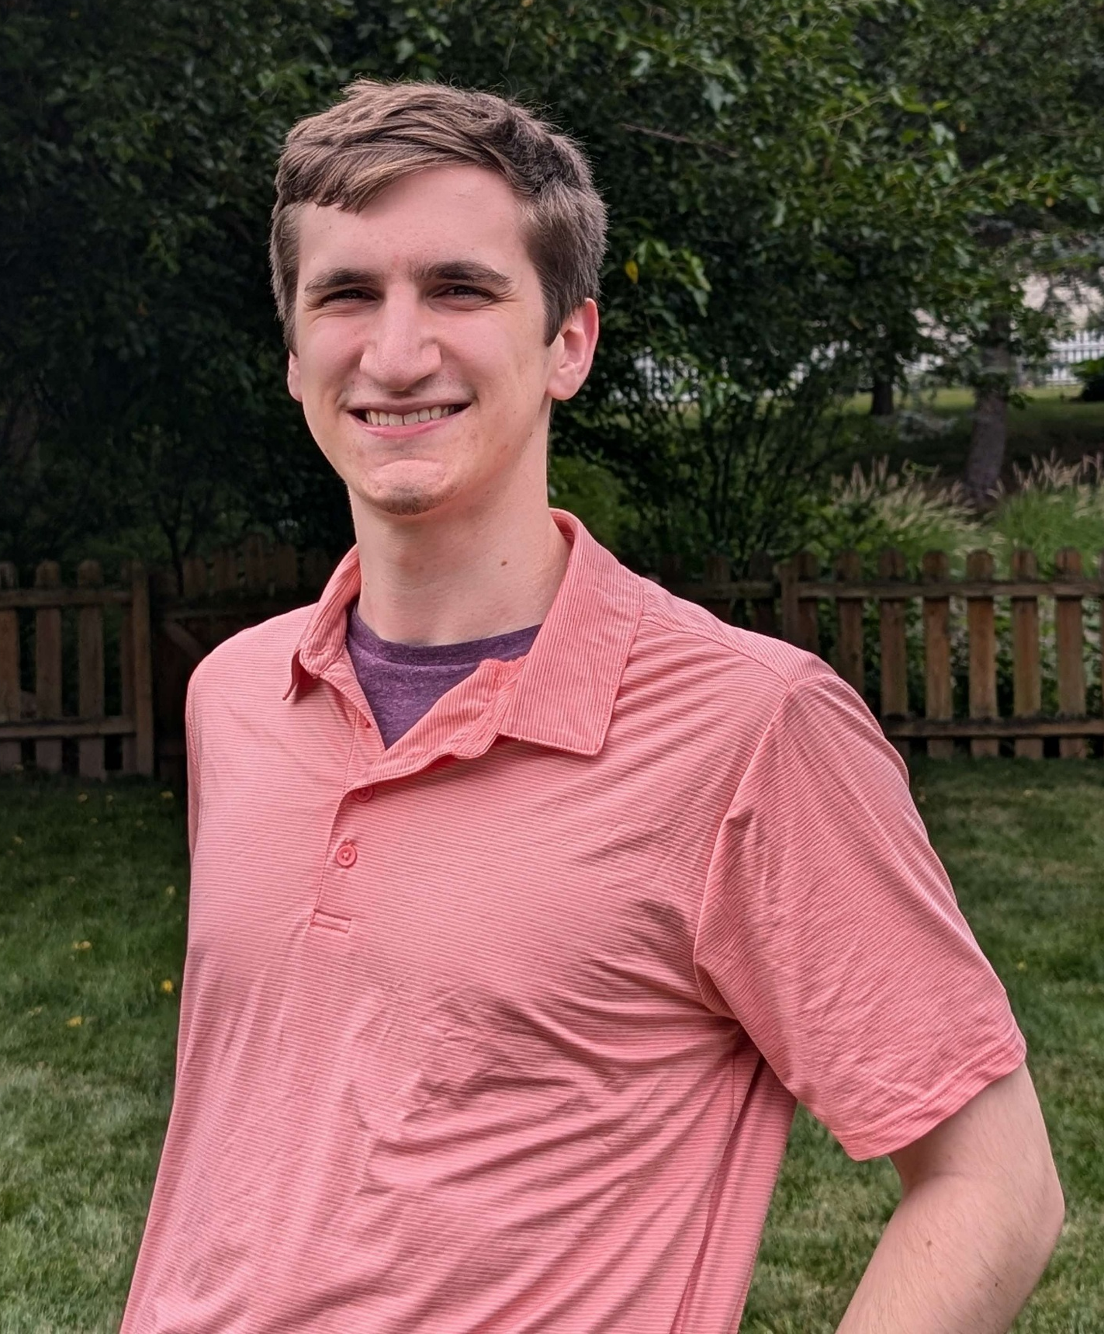
Team Profile
Isaac Eberhard
Team Role: Team Lead, Full-Stack
Professional Background: IT DevOps/Systems Administration at Perry ProTECH
Skills: Python, Javascript, Java, C, SQL, MongoDB, Jinja.
Ethan Byers
Team Role: Front-end Design
Professional Background: Software engineer at Raytheon
Skills: Front-end development, UI/UX, art & design, visual development (Swing)

Slide 3
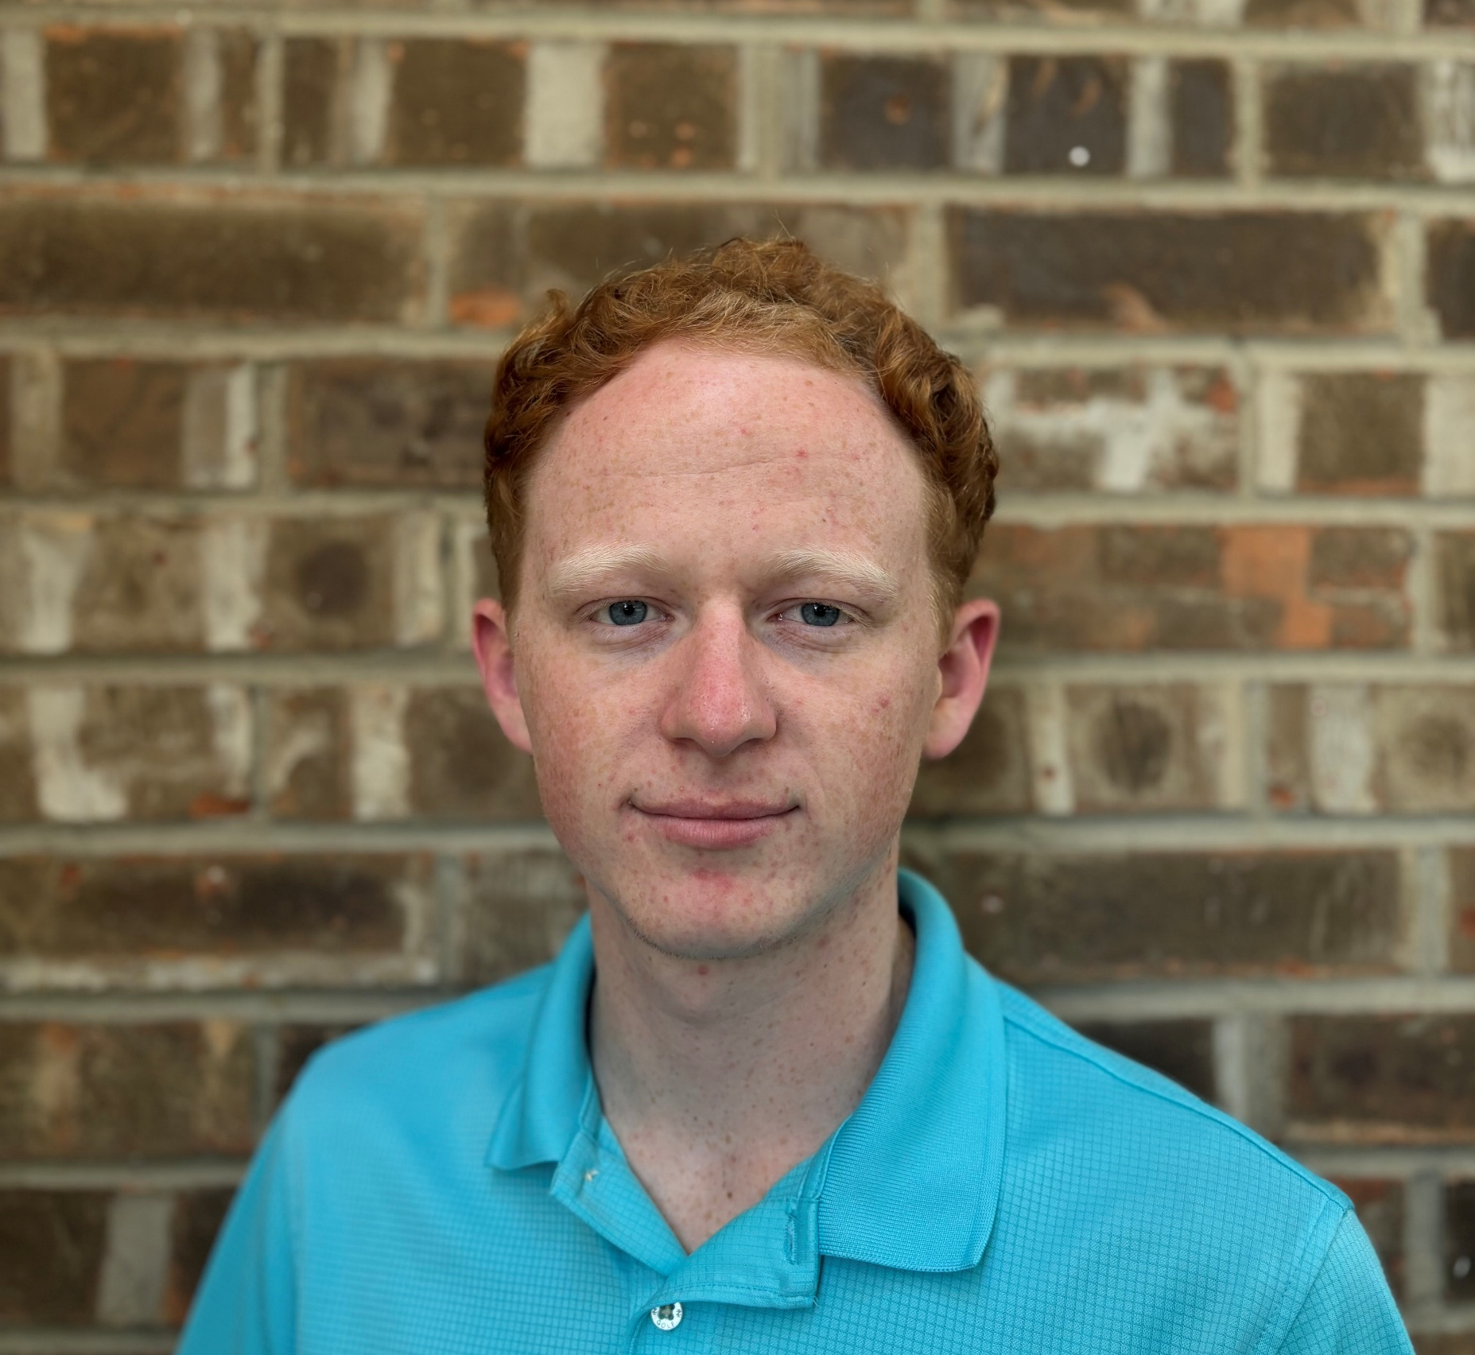
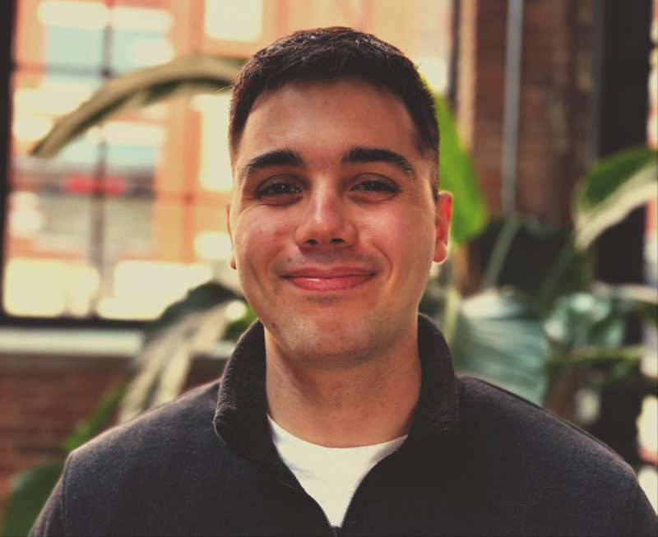
Team Profile
Trevor Lemert
Team Role: Backend / QA Tester
Professional Background: Software Engineering Intern @ Idemia
Skills: C#, Java, C++, SQL, MongoDB, Debugging
Cody Bergman
Team Role: Full-Stack / QA Tester
Professional Background: System Administrator @ Pinnacle Technology Solutions and Application Developer @Medpro Group
Skills: React, REST API, DevOps, Research, Psychology, Documentation

Slide 4
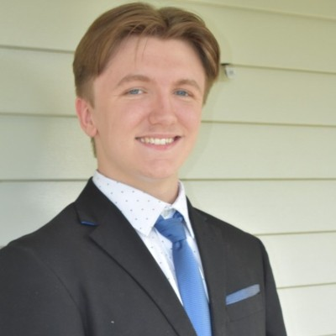
Team Profile
Tyler Likens
Team Role: Full Stack
Professional Background: Full Stack Developer Intern @ Juvare
Skills: Front-end development, UI/UX, Prototyping (Figma)

Slide 5
Project Background
Dr. Brandon McDaniel and his team conducted a 2-year study funded by the NIH
Heavy smartphone usage and depressive symptoms connected in parents
Haphazard smartphone use can reduce quality of parent-child interactions
In response, the team began a new project:
Create a web-based learning portal to help parents cultivate healthy digital habits
Allow Parkview researchers to survey parents and analyze data

Slide 6
Project Impact
Numerous Positive Community Benefits
Promote more thoughtful smartphone usage in adults
Improve parents' mental and emotional bandwidth
Facilitate more positive parent-child interactions
Improve household dynamics across Fort Wayne
Project data can contribute to a better understanding of smartphone use, parenting, and mental and emotional wellbeing

Slide 7
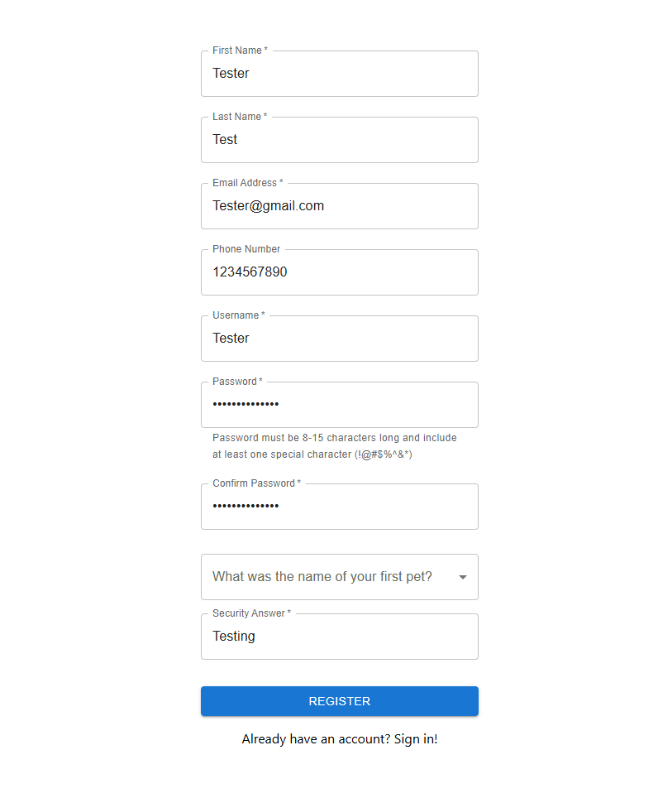
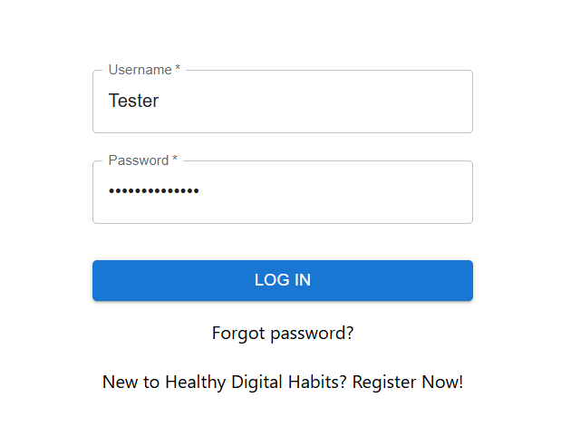
Current State – Registration and Sign-in

Slide 8
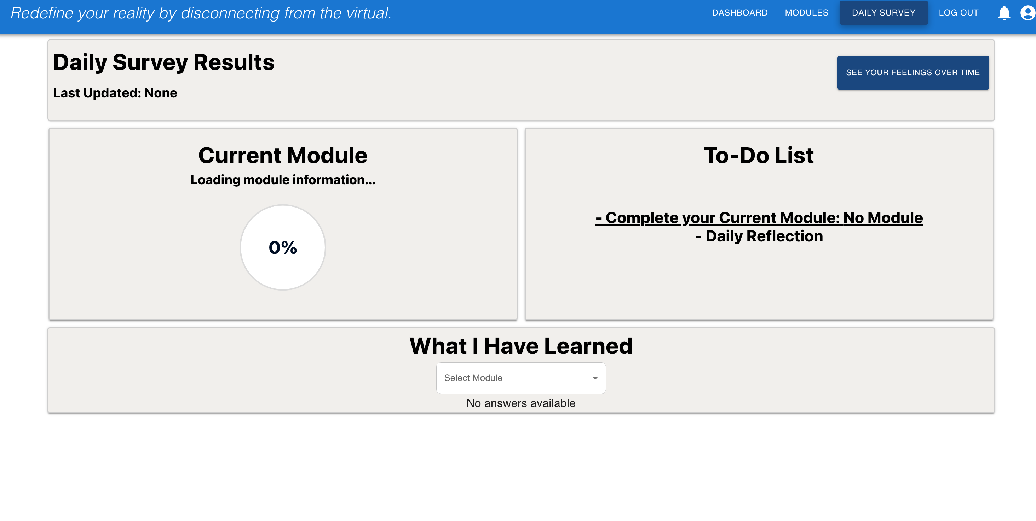
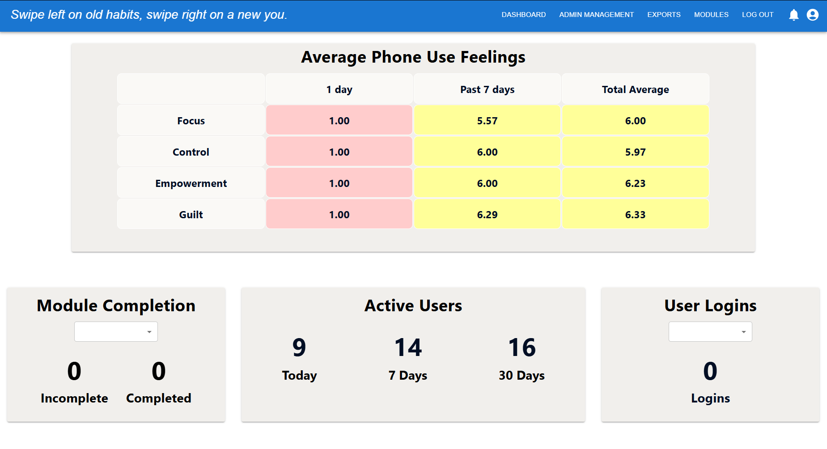
Current State – Parent/Admin Dashboard
Local Instances Only – No DEV environment yet
Parent View
Admin View

Slide 9
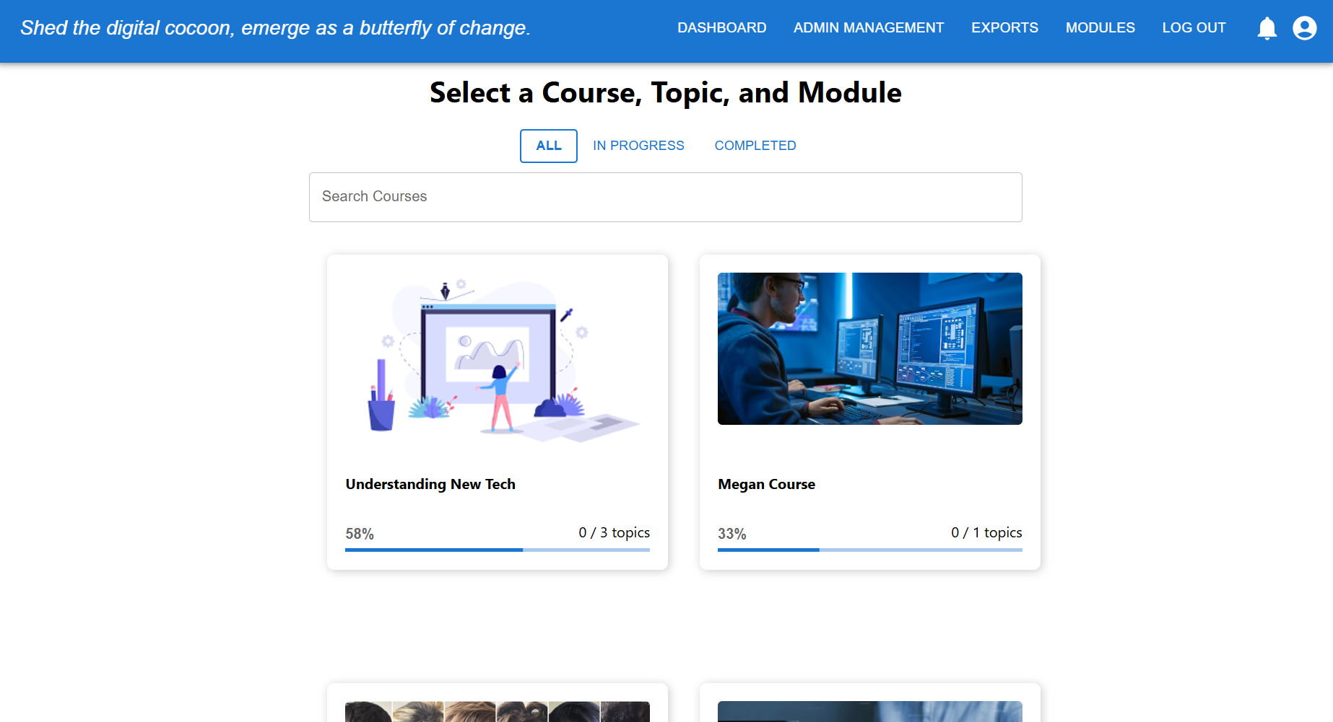
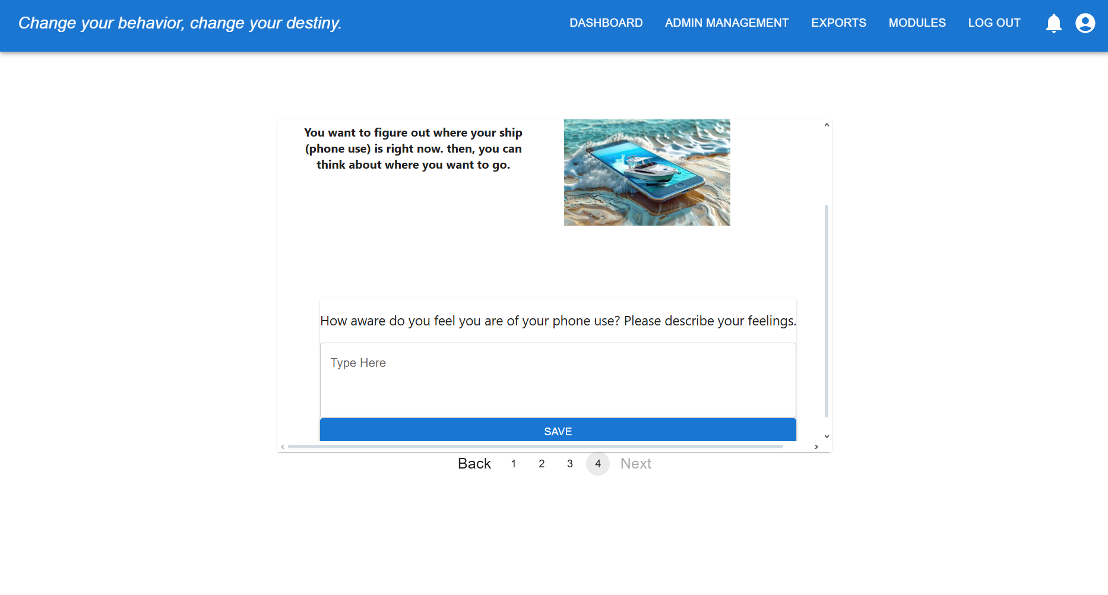
Current State – Module & Course

Slide 10


Requirements
Administration panel
Hierarchical course, module, topic/quiz structure
Decision tree branching based parent responses
Improved admin analytics dashboards
User Panel
Improved UI/UX to be more engaging
Enforcement of the course, module, topic/quiz structure
Site wide
Mobile friendly parent dashboard
Bug fixes from V2
WCAG 2.1 A accessibility compliance

Slide 11
Stretch Goals
Cloud hosting through one of the big three (AWS/GCP/Azure)
Notification system (progress/new module alerts)
Messaging/community board
Version history for the admin course builder view
Gamification (streak counters, badges)

Slide 12




Technology Stack
Database
MongoDB
Backend
Express.js
Node.js
Frontend
React
Subject to change
May incorporate Editor.js or Tailwind

Slide 13





Additional Resources
Version Control
Github
Project Management Tool
Jira
Project Documentation Tool
Confluence
Primary IDE
VSCode
Team Communication
Discord

Slide 14
Technical Challenges
Hierarchical course building (admin side)
Flexible schema in MongoDB
Decision tree logic for adaptive learning
Dynamic branching rules personalized on parents' responses
Dashboards
Role based views (admin views aggregate data and parents see personalized data)

Slide 15
UI/UX Challenges
Admin impersonation of parent users
Admin can view session as parent to test course design and flow
Navigation clarity
Intuitive, clear indicators of progress
Mobile optimization
Dashboards and course content usable on small screens

Slide 16
Q&A

